Slide 1
Material Sharing
@15 March 2018
Reporter: Jerry Chang

Slide 2
Topics
Set including path in Genus
Wire Load Model(WLM)
  Read Wire Load Model(WLM) attributes in Liberty file (.lib)
  Setup WLM in GENUS
Usage of syn_generic, syn_map, and syn_opt
Low power setting in GENUS

Slide 3
Set including path in Genus

Slide 4
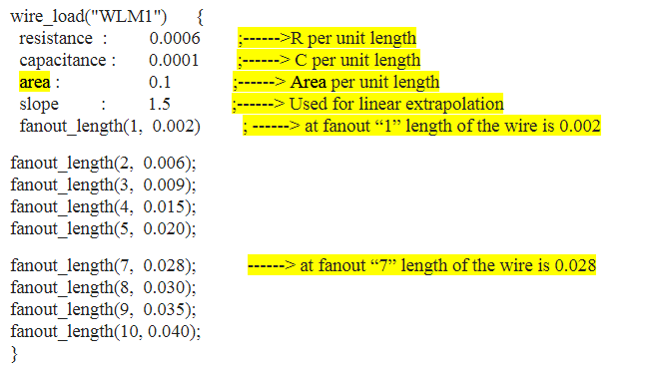
Read Wire Load Model attributes in Liberty file
How to read wire_load_model in Liberty file
You can choose different WLM in lib for different module
Reference site: http://www.vlsi-expert.com/2012/03/delay-wire-load-model-static-timing.html

Slide 5
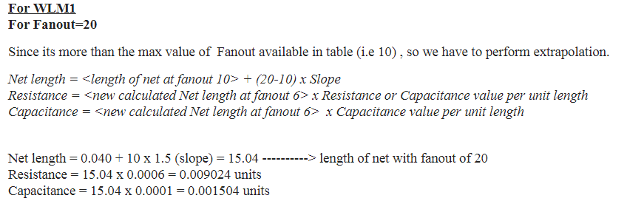
Read Wire Load Model attributes in Liberty file
Example to calculate exploration case

Slide 6
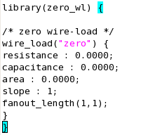
Extend.
Create zero wire load model for DC or PT.
You have to create a “fake” .lib file and using lc_shell to transform to .db

Slide 7
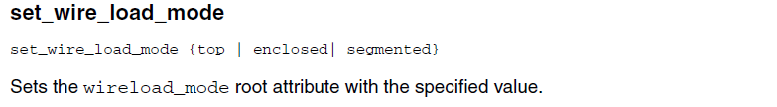
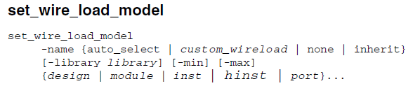
How to setup WLM in GENUS
Set wire load mode
Set wire load model
Example for setting no wire model:

Slide 8
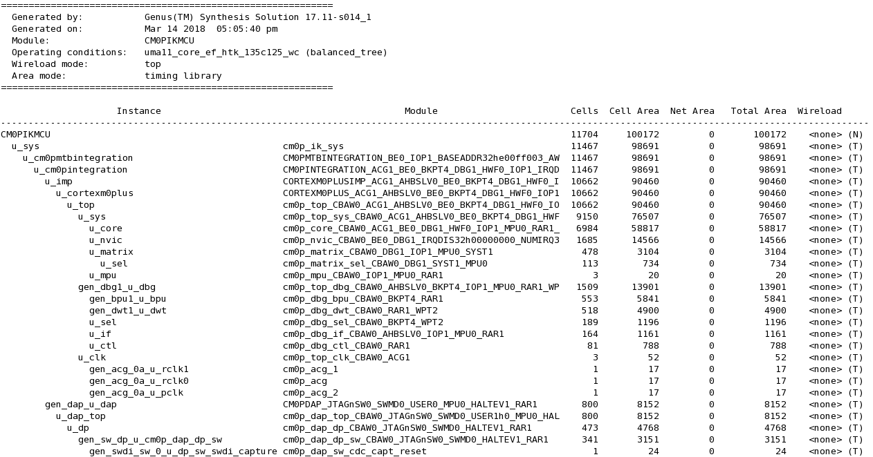

Check to use NO-WLM

Slide 9
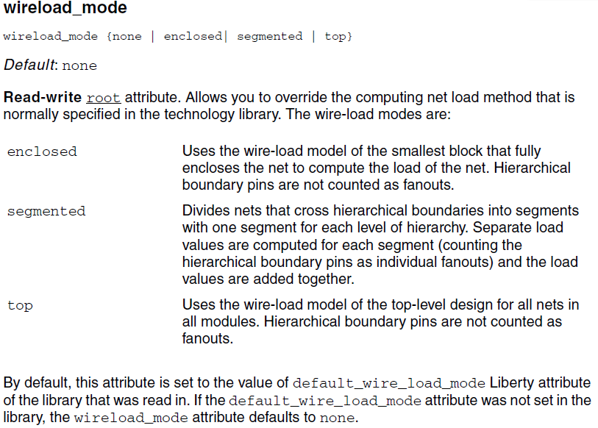

Slide 10
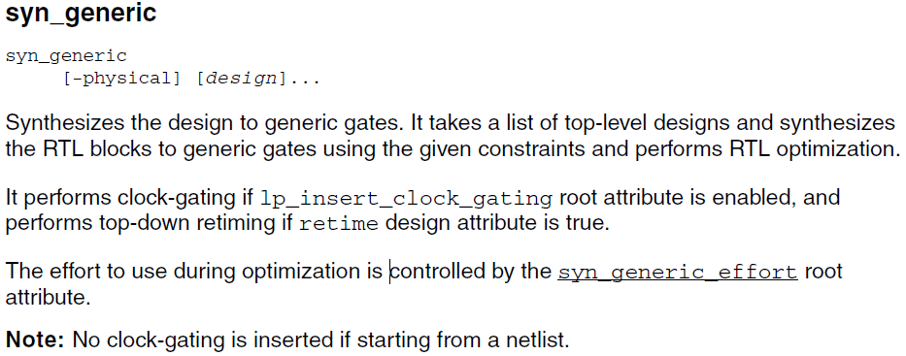
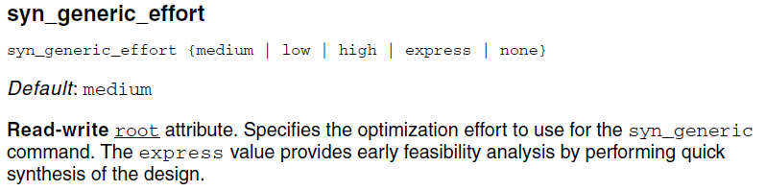
Usage of syn_generic, syn_map, and syn_opt

Slide 11
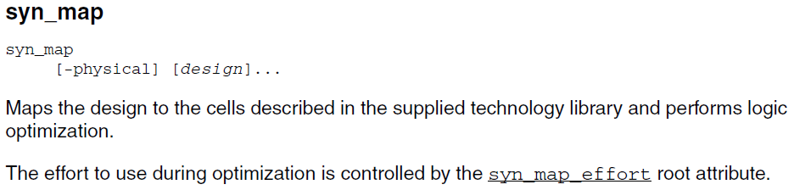
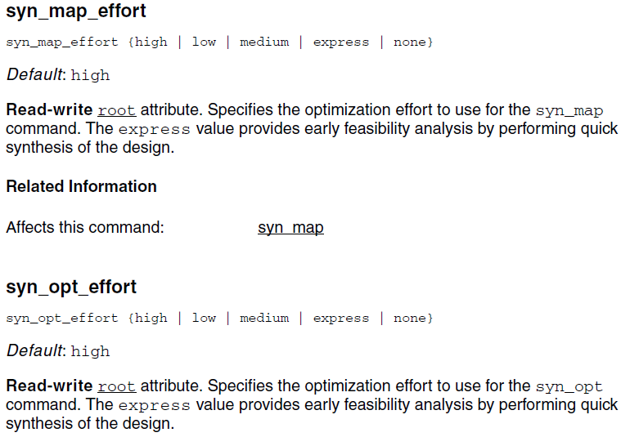
Usage of syn_generic, syn_map, and syn_opt

Slide 12
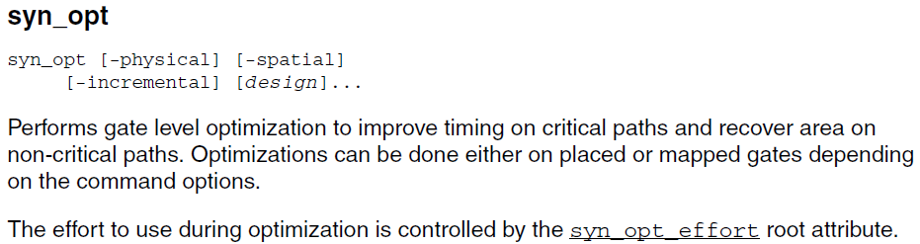
Usage of syn_generic, syn_map, and syn_opt

Slide 13
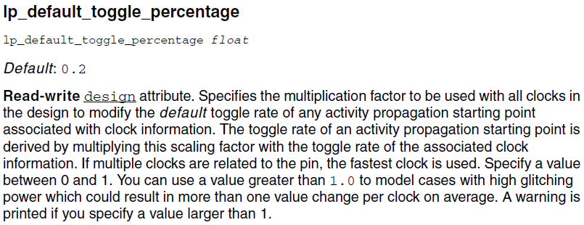
Low power setting in GENUS

Slide 14
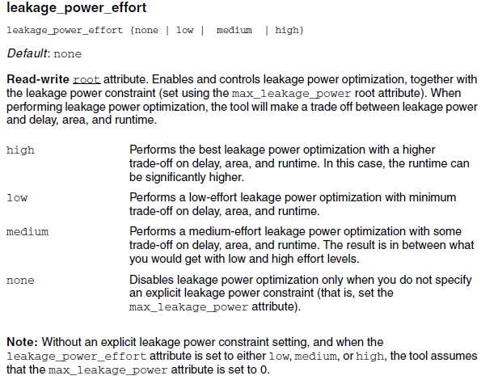
Low power setting in GENUS

Slide 15
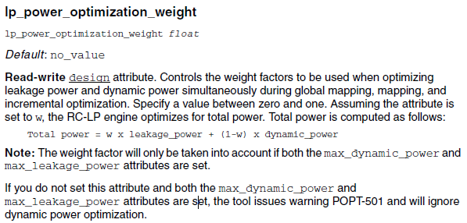
Low power setting in GENUS

Slide 16
Material Sharing
@21 March 2018
Reporter: Jerry Chang

Slide 17
Topics
set_false_path v.s. set_disable_timing
Clock source latency & Clock network latancy
Delay Time Calculation (not study yet)
Unate & Non-unate

Slide 18
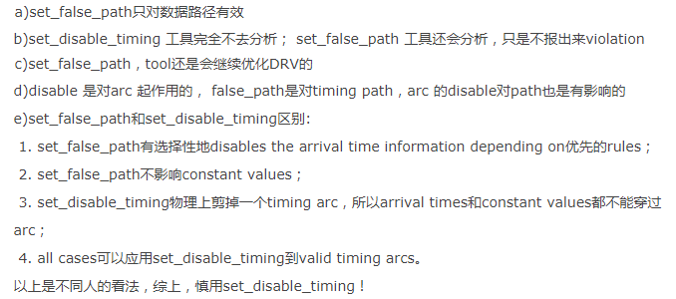
set_false_path v.s. set_disable_timing
對clock path 無效

Slide 19
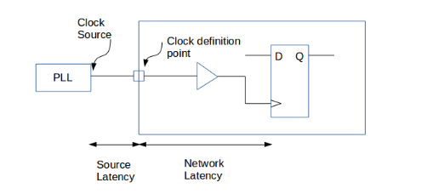
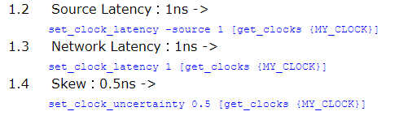
Clock source latency & Clock network latency

Slide 20
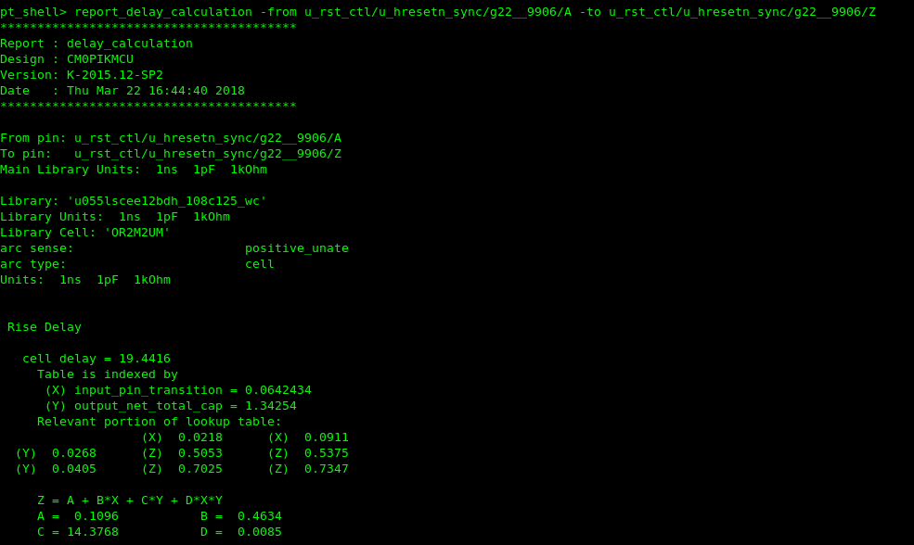
Delay Time Calculation (not study yet)

Slide 21
Unate & Non-unate
Unate: 當輸入一邊固定時,輸出可以由另一邊輸入單獨決定
Non-unate:輸出無法由特定輸入單獨決定

Slide 22
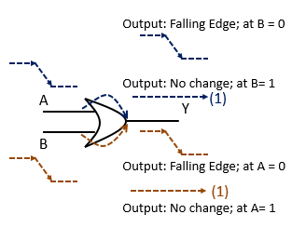
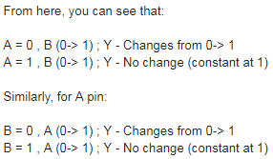
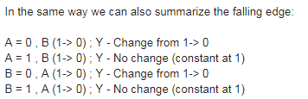
Unate & Non-unate
Example: OR Gate
OR GATE is positive unate
Reference: http://www.vlsi-expert.com/2016/12/unate-timing-arc.html

Slide 23
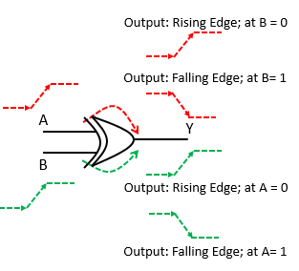
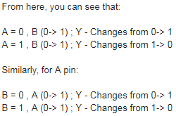
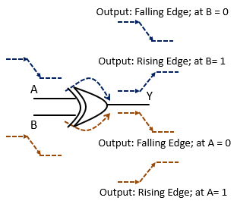
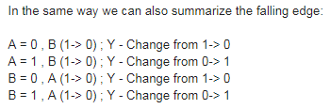
Example: XOR Gate
XOR GATE is non-unate

Slide 24
Material Sharing
@27 March 2018
Reporter: Jerry Chang

Slide 25
Topics
How to read/write genus attributes
Group of attributes: hinst, hpins, hnets

Slide 26
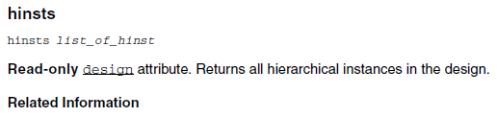
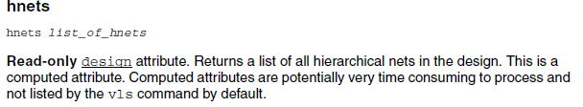

Group of attributes: hinst, hpins, hnets

Slide 27

How to read/write genus attributes

Slide 28
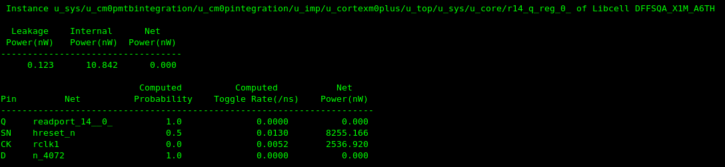
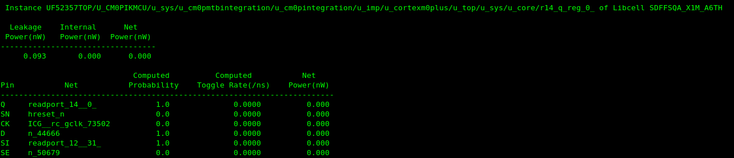
Toggle rate

Slide 29
Material Sharing
@3 April 2018
Reporter: Jerry Chang

Slide 30
Topics
How to change the default color scheme of GVIM
How to install PERL module locally

Slide 31
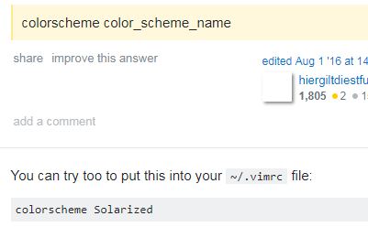
How to change the default color scheme of GVIM
Step 1 : go to your home dir.
Step 2 : edit .vimrc and set colorscheme
Question: Help to set filetype for systemverilog

Slide 32
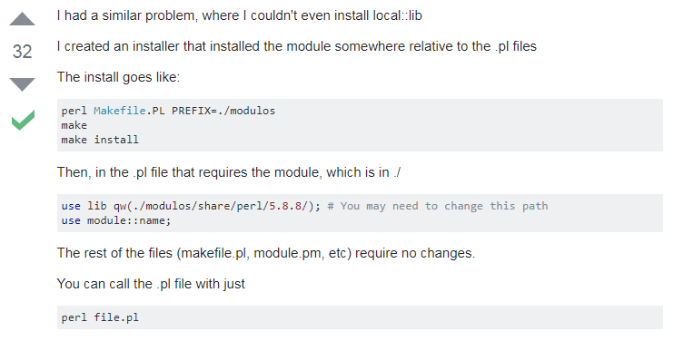
How to install PERL module locally

Slide 34
Material Sharing
@9 April 2018
Reporter: Jerry Chang

Slide 35
Topics
LEC Setting file discussion
Difference between IAP/ICP/ISP
Volatile on Embedded C

Slide 36
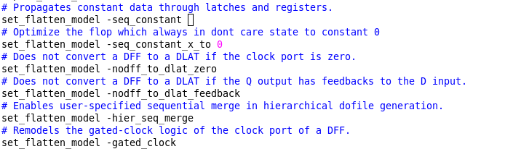
Default Setting for LEC

Slide 37
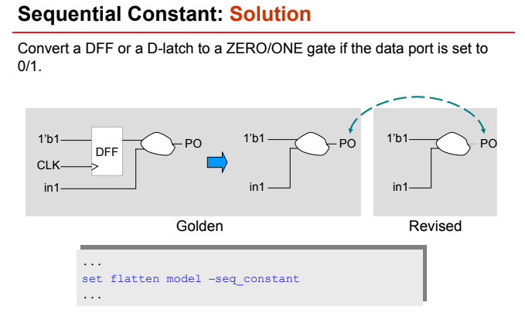

Slide 38
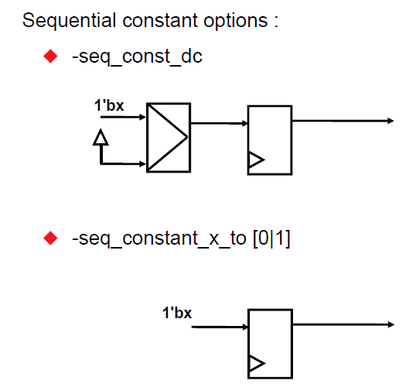

Slide 39
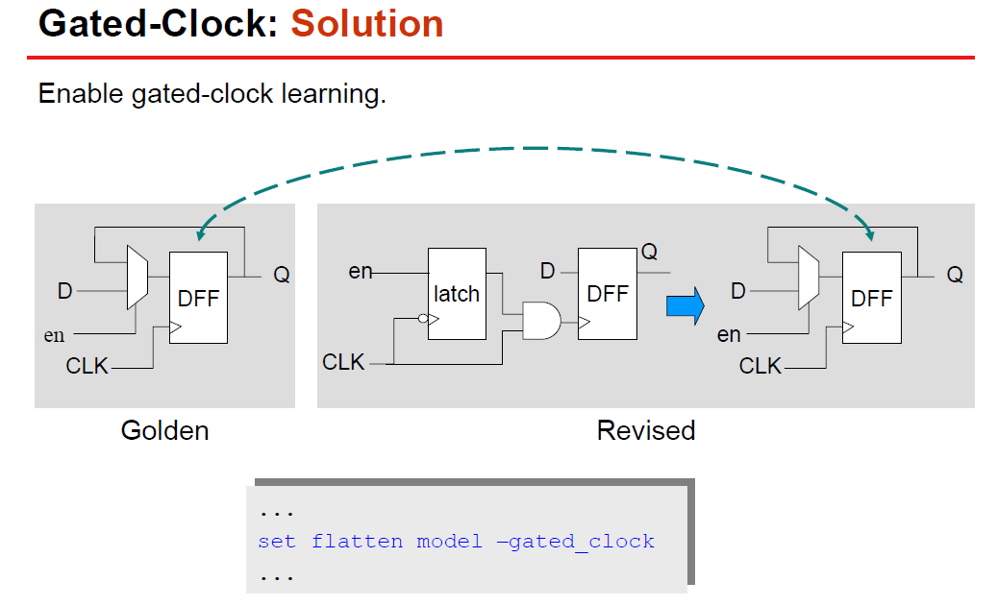

Slide 40
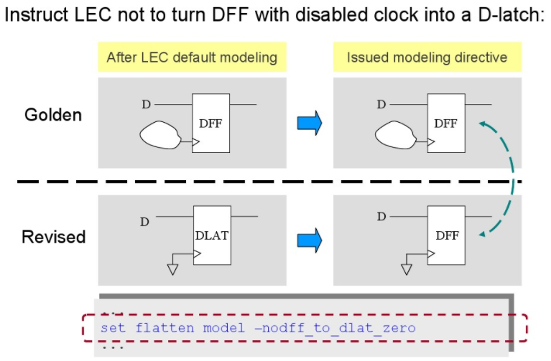

Slide 41
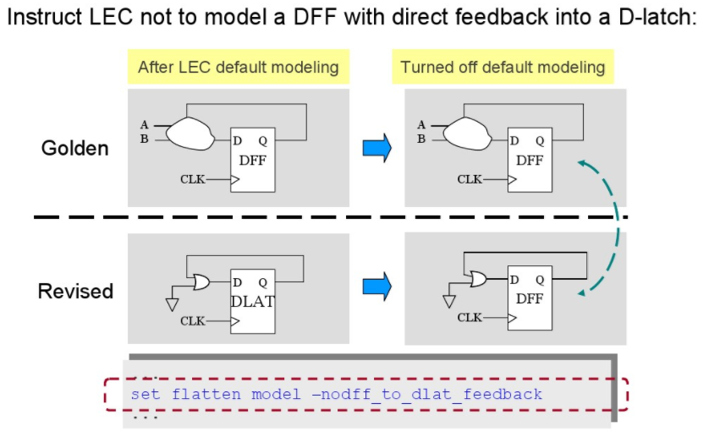

Slide 42
Differences between IAP/ICP/ISP
https://wenku.baidu.com/view/567a578c680203d8ce2f24a7.html

Slide 43
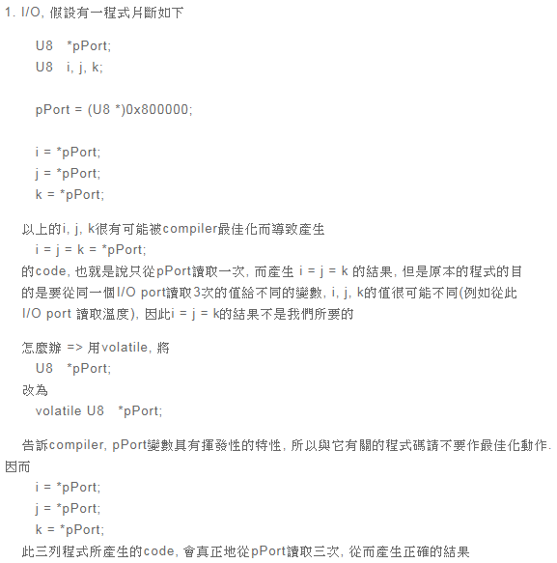
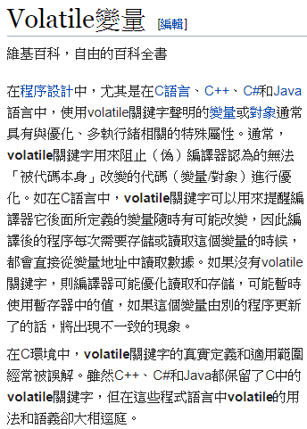
Volatile on Embedded C

Slide 44
Material Sharing
@16 April 2018
Reporter: Jerry Chang

Slide 45
Outline
Keil C Clock Setting file (startup.s)

Slide 46
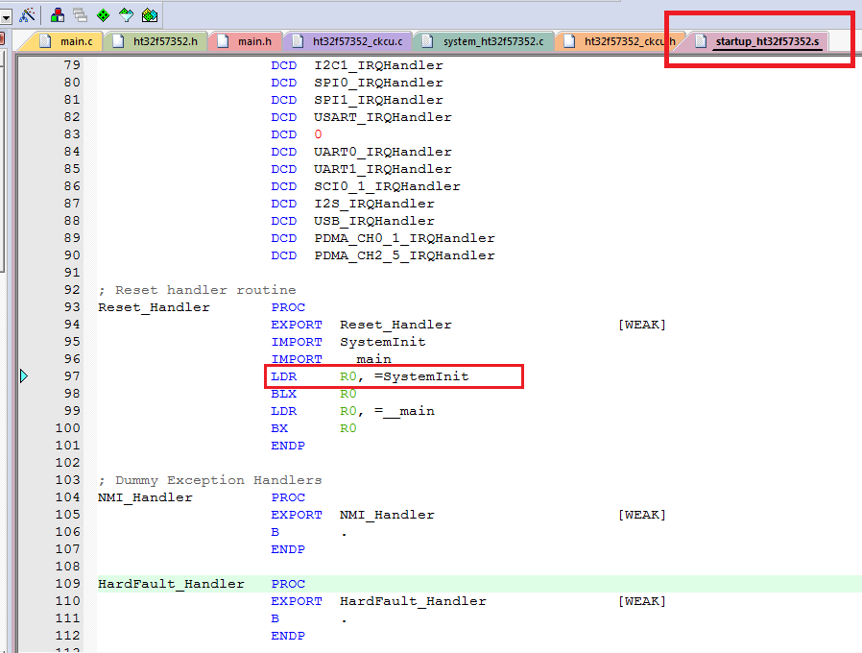
Keil C Clock Setting file (startup.s)
Keil C compiler will use the assemble file “startup_h32F57352.s” to initialize the system setting (e.g., clock).
As shown is this figure, this
assemble code will call
the function “SystemInit”
which referenced in
“system_ht32f57352.c”

Slide 47
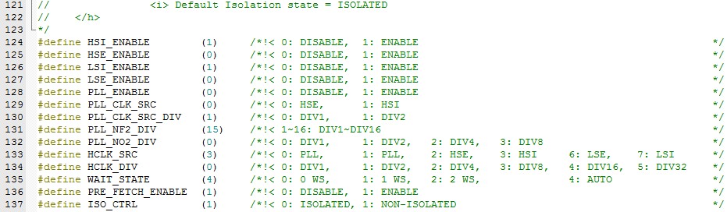
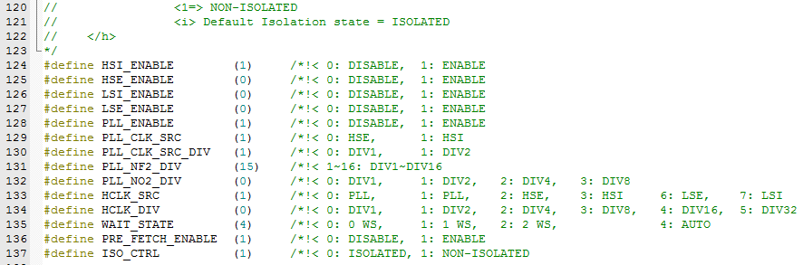
Keil C Clock Setting file (system_ht32f57352.c)
E.g. 8MHz setting
E.g. 60MHz setting

Slide 48
Material Sharing
@23 April 2018
Reporter: Jerry Chang

Slide 49
Outline
How to trace the specified BUS values and Mark the line of time radix in Verdi
#IRQ Handler and Interrupt routine.

Slide 50
Material Sharing
@2 May 2018
Reporter: Jerry Chang

Slide 51
Outline
SDC modification process before netlist released
Timing check after APR released (TBD)

Slide 52

SDC modification process before netlist released
Released items
  Netlist (.v)
  SDC
write out tcl
  write_sdc -version 1.7 > ./NETLIST/UM01UMH711_dc.sdc
Remove case_analysis in sdc
Set current design

Slide 53
Material Sharing
@8 May 2018
Reporter: Jerry Chang

Slide 54
Outline
Get clock attribute on Genus
Report synthesis message to check the constraints
How to disable non-used clock in STA

Slide 55
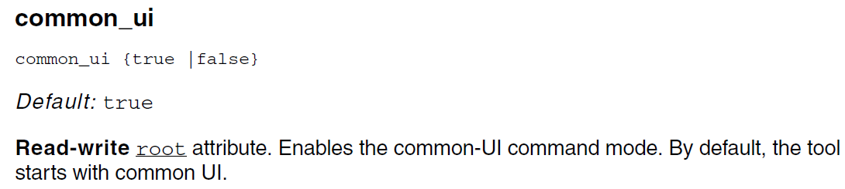
Get clock attribute on Genus
1. set into common_ui to true to combatable RC compiler commands. (enter lagency_ui)
2. get_attribure propragated_clocks OBJECT

Slide 56
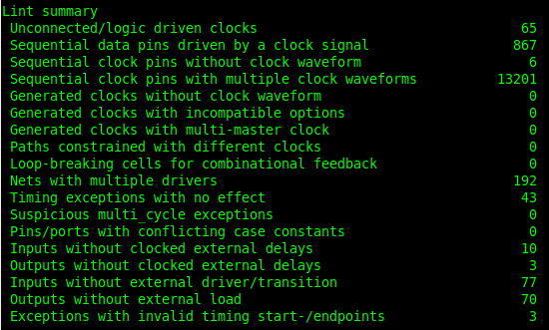
Report synthesis message to check the constraints
It can reports the following information to check the timing and its sdc setting.

Slide 57
How to disable non-used clock in STA
Set_clock_sence –stop_propagation –clock [CLOCK] [PORTS/PINS]
Reference link:
The command “set_clock_sense” can be applied in many cases of STA.
http://www.cnblogs.com/-9-8/p/5730446.html

Slide 58
Material Sharing
@29 May 2018
Reporter: Jerry Chang

Slide 59
Outline
How to debug when NCSIM stuck at a time point

Slide 60
How to debug when NCSIM stuck at a time point
Add “-linedebug” in option
Run simulation and then ctrl+c to stop the simulation. It will shows the instruction line and stuck point in your code.

Slide 61
Material Sharing
@4 June 2018
Reporter: Jerry Chang

Slide 62
Outline
What is Polymorphism
UVM Study recording

Slide 63
What is Polymorphism
Polymorphism (多態)
http://www.runoob.com/cplusplus/cpp-polymorphism.html
Use virtual function in parent class to info compiler, there should be a function here which is declared in children class.

Slide 64
验证平台的组成
  DUT: Design under test
  Monitor
  Driver
  Reference model
  Scoreboard

Slide 65
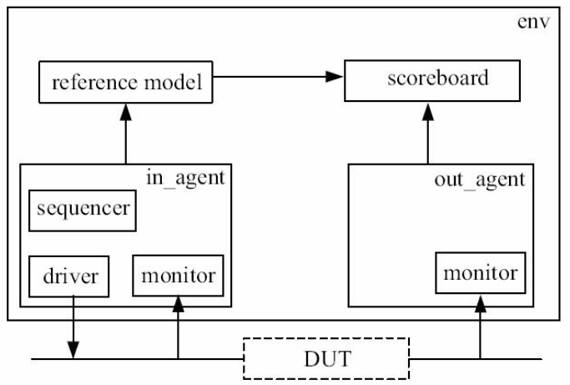
UVM Study recording

Slide 66
UVM Study recording
文件：top_tb.sv
1 `timescale 1ns/1ps
2 `include "uvm_macros.svh"
3
4 import uvm_pkg::*;
5 `include "my_driver.sv"
6
7 module top_tb;
8
9 reg clk;
10 reg rst_n;
11 reg[7:0] rxd;
12 reg rx_dv;
13 wire[7:0] txd;
14 wire tx_en;
15
16 dut my_dut(.clk(clk),
17 .rst_n(rst_n),
18 .rxd(rxd),
19 .rx_dv(rx_dv),
20 .txd(txd),
21 .tx_en(tx_en));
22
23 initial begin
24 my_driver drv;
25 drv = new("drv", null);
26 drv.main_phase(null);
27 $finish();
28 end
29
30 initial begin
31 clk = 0;
32 forever begin
33 #100 clk = ~clk;
34 end
35 end
36
37 initial begin
38 rst_n = 1'b0;
39 #1000;
40 rst_n = 1'b1;
41 end
42
43 endmodule

Slide 67
文件：my_driver.sv
3 class my_driver extends uvm_driver;
4
5 function new(string name = "my_driver", uvm_component parent = null);
6 super.new(name, parent);
7 endfunction
8 extern virtual task main_phase(uvm_phase phase);
9 endclass
10
11 task my_driver::main_phase(uvm_phase phase);
12 top_tb.rxd <= 8'b0;
13 top_tb.rx_dv <= 1'b0;
14 while(!top_tb.rst_n)
15 @(posedge top_tb.clk);
16 for(int i = 0; i < 256; i++)begin
17 @(posedge top_tb.clk);
18 top_tb.rxd <= $urandom_range(0, 255);
19 top_tb.rx_dv <= 1'b1;
20 `uvm_info("my_driver", "data is drived", UVM_LOW)
21 end
22 @(posedge top_tb.clk);
23 top_tb.rx_dv <= 1'b0;
24 endtask

Slide 68
Material Sharing
@2 August 2018
Reporter: Jerry Chang

Slide 69
SDF format brief introduction

Slide 70
SDF format brief introduction
SDF file typically has a section similar to the one below.
  Interconnect
(CELL
(CELLTYPE "digital_top")
(INSTANCE)
(DELAY
(ABSOLUTE
(INTERCONNECT in1 top/test_reg/D (0.0027::0.0028) (0.0029::0.0030))
(INTERCONNECT top/test_reg/Q chain_reg/D (0.0000::0.0002) (0.0000::0.0003))
0->1
1->0
a delay can be a single value or three values representing minimum, typical, and maximum delays in the form (min:typ:max)

Slide 71
SDF format brief introduction
  Interconnect
(CELL
(CELLTYPE "SDFF") → Specify the cell type, it can be a DFF, combinational cell, or an module
(INSTANCE top/test_reg)
(DELAY
(ABSOLUTE
(IOPATH CLK Q (0.2864::0.2865) (0.3616::0.3617))
(IOPATH CLRZ Q () (0.8764::0.8765))
)
)
(TIMINGCHECK
(RECREM (posedge CLRZ) (posedge CLK) (0.1540::0.1540) (0.1961::0.1961))
(SETUPHOLD (posedge D) (posedge CLK) (0.5805::0.5805) (-0.1512::-0.1512))
(SETUPHOLD (negedge D) (posedge CLK) (0.8792::0.8792) (-0.1725::-0.1725))
(WIDTH (posedge CLK) (0.3692::0.3692))
(WIDTH (negedge CLRZ) (0.3975::0.3975))
)
)
0->1
1->0
Specify the timing check with different timing arc.

Slide 72
Material Sharing
@9 August 2018
Reporter: Jerry Chang

Slide 73
Outline
Point for LEC check for PRE2POST script

Slide 74
Point for LEC check for PRE2POST script
Hier. compare
  write_hier_compare_dofile hier_tmp.lec.do -noexact_pin_match -constraint -usage -replace -balanced_extraction -function_pin_mapping
  run_hier_compare hier_tmp.lec.do -dynamic_hierarchy
  The non-eq. module pairs can be waived if the result is PASS
Flatten compare
  set_system_mode lec
  add_compared_points -all
  compare -verbose

Slide 75
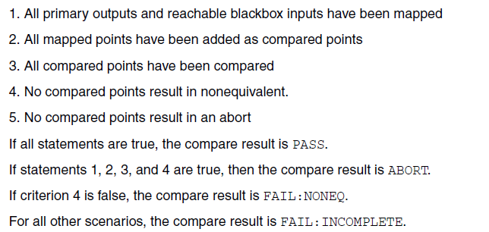
Point for LEC check for PRE2POST script

Slide 76
Material Sharing
@4 September 2018
Reporter: Jerry Chang

Slide 77
Outline
Some Additional Features in SystemVerilog
  Class
    Extends (inherited from parent class, not discussed here)
    This (this class), super (parent class, not discussed here)
    Parameterized Classes
    Shallow/Deep Copy
    Extend function
  Fork and join
    Fork-Join
    Fork-Join_any
    Fork-Join_none
  Clocking
  Interface
  IPC ( Not correct yet)
    Semaphore
    Mailbox
    Event
  SVA
http://www.verificationguide.com/p/systemverilog-tutorial.html

Slide 78
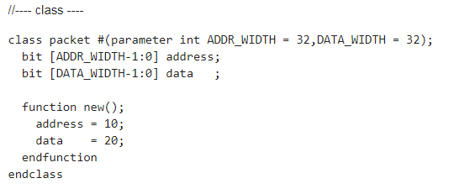
Class – Parameterized Classes

Slide 79
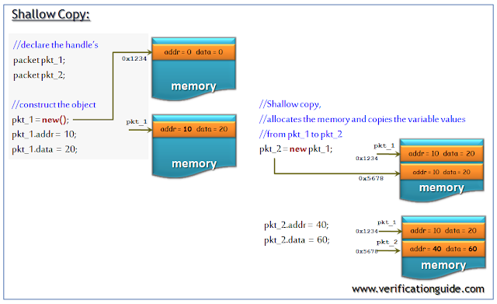
Class – Shallow/Deep Copy
Shallow Copy

Slide 80
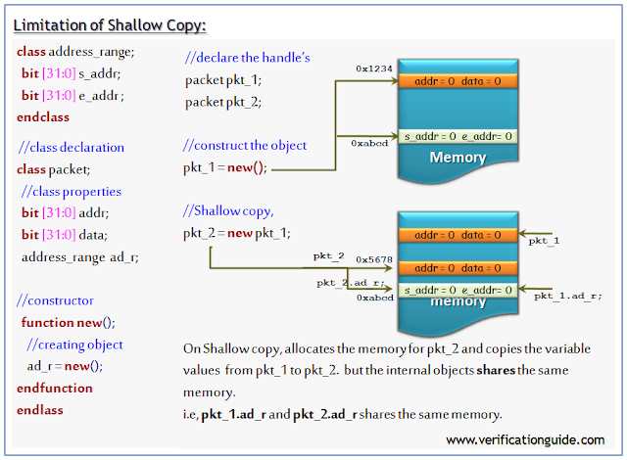
Class – Shallow/Deep Copy
Limitation Shallow Copy
  Can not copy the internal class.

Slide 81

Class – Shallow/Deep Copy
Class Assignment vs. Shallow Copy
  Class assignment can be regarded as “pointer” in C

Slide 82

Class – Shallow/Deep Copy
Deep Copy - TBD

Slide 83

Extend function
Definition of method can be written outside the body of class.

Slide 84

Fork and join
Fork-Join is scheme to create several processes and they parallel do their task at same time.

Slide 85


Fork and Join
Example of Fork-join

Slide 86

Fork and Join
Fork-Join_any
  Fork-Join_any will be un-blocked after the completion of any of the Process.

Slide 87


Fork and Join
Example of Fork-Join_any

Slide 88

Fork and Join
fork join_none
  As in case of Fork-Join and Fork-Join_any fork block is blocking, but in case of Fork-Join_none fork block will be non-blocking.
  Processes inside the fork-join_none block will be started at the same time, fork block will not wait for the completion of Process inside the fork-join_none.

Slide 89


Fork and Join
Example of fork join_none

Slide 90

Clocking – Clocking block

Slide 91

Clocking – Clocking block

Slide 92

Default clocking
The unit of delay can be applied in “default clocking”

Slide 93

modport
This gives an example to illustrate the modport. The signals in this interface can be reorganized as each modports. This can increase the reused ability for RTL code.
http://www.asic-world.com/systemverilog/interface3.html

Slide 94
Material Sharing
@16 October 2018
Reporter: Jerry Chang

Slide 95
Outline
Verification Plan using SV
  Overview
  Feature Extraction
  Stimulus Generation Plan
  Coverage Plan
  Verification Environment
http://www.testbench.in/SL_03_VERIFICATION_PLAN.html

Slide 96


Overview
The following figure gives an example to explain the verification plan. We may refer to this example to create out verification environment.
DA: Destination address of the packet
SA: Source address of the packet
Length: Length of the data : from 0 to 255 (Unit: Byte)
Data: Data should be in terms of bytes and can take anything.
FCS: Frame check sequence (CRC)
Setting of Dest. Address
for Port 0 to 3
Input packet
Output packet
DUT
Packet Structure

Slide 97


Overview
Memory Interface
mem_add[0 to 3] represent the Port 0 to 3
mem_data means the Dest. Address (DA)for the Port.
The following waveform shows the DAs for Port 0 to 3
are 0x05, 0x03, 0x00, 0xf1

Slide 98


Overview
Input Port
A complete packet.
The “05” is the Dest. Address.
According to the pervious slide. This packet will
be sent to Port 0
05
9f
05
09
05
be
d5
d1

Slide 99


Overview
Output Port

Slide 100
Feature Extraction
This section contains list of all the features to be verified
  ID: Configuration
    Description: DA field of packet should be any of the port address. All the 4 port address should be used.
  ID: Packet DA
    DA field of packet should be any of the port address. All the 4 port address should be used.
  ID : Packet payload
    Length can be from 0 to 255. Send packets with all the lengths.
  ID: Length
    Length field contains length of the payload.
    Send Packet with correct length field and incorrect length fields.
  ID: FCS
    Good FCS: Send packet with good FCS.
    Bad FCS: Send packet with corrupted FCS.

Slide 101
Stimulus Generation Plan
Packet DA: Generate packet DA with the configured address.
Payload length: generate payload length ranging from 2 to 255.
Correct or Incorrect Length field.
Generate good and bad FCS.

Slide 102
Coverage Plan
Cover all the port address configurations.
Cover all the packet lengths.
Cover all correct and incorrect length fields.
Cover good and bad FCS.
Cover all the above combinations.

Slide 103

Verification Environment

Slide 104
Material Sharing
@26 October 2018
Reporter: Jerry Chang

Slide 105
Some Perl Notice
Perl symbols
  $variable
  @array
  %hash
  () -> array , e.g. ( “a”, “b”)
  [] -> a address of array e.g, [452,”f1”]
  {} -> a hash element

Slide 106
Some Perl Notice
Check File exist

Slide 107
Material Sharing
@14 Jan. 2019
Reporter: Jerry Chang

Slide 108
LEC R2PRE notice
Two Phases
  'fv_map' netlist vs. revised netlist.
  RTL vs. 'fv_map' netlist.
Two phases have to tie 0.
  fv_map netlist is an intermediate netlist which already change DFF to SCAN DFF but the SE was a constant 0.
  We have to tie scan_mode to 0 in both revised and golden designs to avoid comparing fault.

Slide 109
Basic concept of IR Drop
https://franejian.wordpress.com/2015/12/28/pi-basic-power-tree-ir-drop/

Slide 110
Setup-hold timing
https://zhuanlan.zhihu.com/p/34253965

Slide 111

Recording for wrong delay value setting

Slide 112
Good link
https://zhuanlan.zhihu.com/p/35520466

Slide 113
Material Sharing
@25 Jan. 2019
Reporter: Jerry Chang

Slide 114
Outline
Introduction for System Verilog Assertion (SVA)

Slide 115
Introduction for SVA
What is Assertion?
  https://zh.wikipedia.org/wiki/%E6%96%B7%E8%A8%80_(%E7%A8%8B%E5%BC%8F)
Pros for SVA
  More Simplified coding style than Verilog Assertion
  Easy to maintain and reuse
https://www.verificationguide.com/p/systemverilog-assertion-sequence.html
https://wenku.baidu.com/view/4b9509154028915f814dc282.html?from=search

Slide 116

Steps to create SVA

Slide 117

Example of SVA
sequence seq;
a ##2 b;
endsequence
property p;
@(posedge clk) seq;
endproperty
a_1 : assert property(p);
Note :: sequence begins when signal "a" is high on a positive edge of the clock.
A clock can be specified in a sequence, in a property or even in an assert statement.
Clock defined in the property definition:
2. Create seq. exp.
1. Create Boolean Eq.
3. Create Prop.
4. Assert Prop.

Slide 118
Genvar forloop for SVA
https://stackoverflow.com/questions/12929887/can-i-generate-a-number-of-systemverilog-properties-within-a-loop

Slide 119
Reason for neg. net delay
https://zhuanlan.zhihu.com/p/37243944

